Slide 1
Design Patterns
Gang Of Four

Slide 2
About
Umar Lone
Founder of Poash Technologies [www.poash.com]
Trainer, developer, mentor, consultant
C/C++, STL, Win32 SDK, MFC, COM, ATL, Design Patterns, Linux, Bash Shell Scripting, Core Java, .NET Framework, C#, Android, Objective C, iOS, OOAD, OpenMP
umar.lone@poash.com

Slide 3
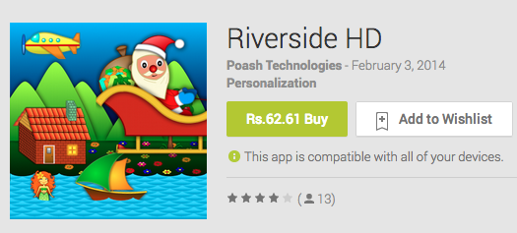

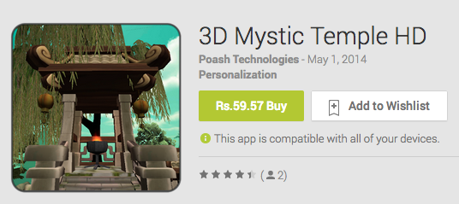


Apps

Slide 4
Objectives
At the end of this training, you’ll be able to
Understand & implement design principles
Identify bad design
Identify situations that require patterns
Identify patterns in existing code
Implement patterns in Java, C++ or C# (or any OO language)

Slide 5
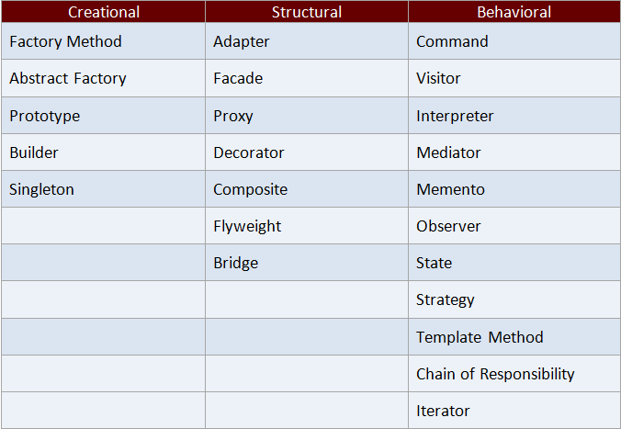

Slide 6
Purpose of Software
Why do we write software?
to solve problems
to ease complexity
to automate tasks
to work efficiently
…
Is writing software easy?
Software is complex!!!

Slide 7
Why Software Is Complex?
Grady Booch mentions following elements that are responsible for the complexity of the software
Unavoidable domain complexity
Impedance mismatch between users & developers
users may find it difficult to express their requirements
Changing nature of requirements
Difficulty in managing the developmental process
big teams
Flexibility possible through software
Problems of characterizing the behavior of discrete systems
Notes:
The four elements of complexity of software domain are
Complexity of the problem domain – Through software we try to solve a number of problems, which have unavoidable complexities. Think of a simulation application that simulates the working of an aircraft. The raw functionality of such systems is quite difficult to comprehend and also adds up the non functional requirements such as usability, performance, cost, reliability, etc. This unrestrained external complexity is the cause of complexity that Brooke writes about.
The common reason of the complexity is the impedance mismatch that exists between the users of a system and its developers. It is generally hard for the users to express precise requirements in the form that developers can understand. In most of the cases, users have only vague ideas of what they want from the system. Users and developers would usually lack expertise in the problem domain and might have different perspectives and assumptions on the nature of the problem.
Things are further complicated by the fact that the requirements of the software systems often change during its development. After seeing prototypes or design documents, user better understands his needs and articulates his real needs that causes the software to change. Or the requirements might change for a different reason altogether.
Since, a lot of investment in terms of time & money goes into such software, it is not possible to scrap it every time the requirements change
Difficulty of managing the development process – The fundamental task of the software development team is to give an illusion of simplicity. The users have to be shielded from the vast complexity of the software. Such software is huge in size and we try to invent ways of writing less code, such as using frameworks or reusing existing code. The whole process is managed through teams of developers, project managers & architects. It is impossible for one person to understand such system completely. But having teams poses a different set of challenges. More developers mean more complex communication and hence, difficult coordination especially if the teams are in different geographical locations.
Flexibility possible through software – In industries such as manufacturing, construction, etc, most of the components are not produced in-house. Rather, they are ordered from other companies. But in software industry, the opposite is true. Since, software gives us great flexibility, it is possible for the developer to express any kind of abstraction. This turns out to be very addictive, but it also forces the developers to create all the primitive building blocks upon which such abstractions would stand. While other industries have uniform codes and standards, very few standards exist in the software industry. This causes software development to be a human intensive effort
Problems of characterizing the behavior of software systems – It is possible to predict the behavior of certain systems. We know if the brake is applied while the car is moving, the car will come to a stop (assuming the brakes are working fine). But in software systems making such predictions are difficult. A normal sized application might have thousands of variables, multiple threads executing simultaneously, memory allocations on stack & heap, etc. This application is executed on computers which has discrete components with discrete states. Such discrete systems have a finite number of possible states and in large systems there is a combinatorial explosion that makes this number very large. So we try to design our systems with a separation of concerns, so that the behavior of one part may not effect the other. But with so many states & events, it is not always deterministic. In the worst case, an external event may bring down a whole system, simply because the developers failed to account for one particular interaction between events. With modern day systems, it becomes even more difficult

Slide 8
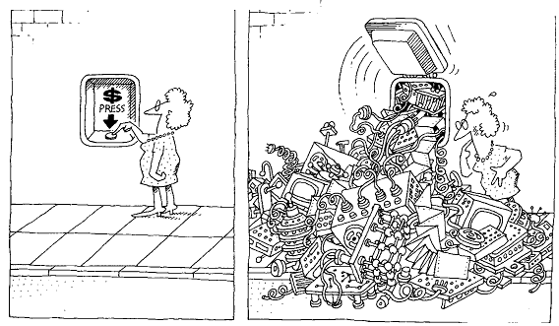
Complexity
Software developers strive to create an illusion of simplicity

Slide 9
How To Resolve Complexity
In software development, the complexity can be resolved in two ways
algorithmic decomposition
object oriented decomposition
Algorithmic decomposition is concerned with the decomposition of problem into algorithms
In object oriented decomposition, we identify players or objects that are part of the system. These objects collaborate with each other to give rise to the functionality of the system
Notes:
Complexity can be resolved through various ways. Dijkstra says, “The technique of mastering complexity has been known since ancient times: divide et impera (divide & rule). When designing any system, it is essential to decompose it into smaller & smaller parts, each of which can be refined independently. This becomes natural for humans to comprehend; only a few parts at once.
In algorithm decomposition, the problem is decomposed as a set of algorithmic steps. Each module in the system may denote a major step of some process
In object oriented decomposition, instead of decomposing the problems in steps, we identify the players (objects) in the system. In such system, the world is viewed as a set of autonomous agents that collaborate to perform some higher level behavior. Each agent (object) has its own set of properties and behaviors. Objects are directed to do things by sending them messages.

Slide 10
Advantages Of OO Decomposition
Can organize the inherent complexity of software systems
Smaller systems through reuse
Resilient to change
Evolve over a period of time
Decomposition is eased by factors such as abstraction & hierarchy
natural outcomes of humans when presented with a problem
Notes:
In structured programming, the complexity increases as the number of lines increase. But through OO decomposition, the system is easier to comprehend & maintain. Two factors help in understanding an OO system – abstraction & hierarchy.
Humans have a powerful technique of dealing with the complexity. We abstract from it. We focus only on important things and ignore the unwanted things, instead dealing with the generalized, idealized model of the object.
Another way of dealing with complexity is by recognizing relationships between objects. One such relationship is hierarchy, where the objects are ordered or ranked. Such ranking represents general or specific functionality of the system

Slide 11
Foundations Of Object Model
Programming languages evolved for developers who were trying to build system using algorithms as their building blocks
Similarly, OO design methods have evolved to help the developers to exploit the power of OO programming languages
So, object model builds upon three concepts
object-oriented analysis
object-oriented design
object-oriented programming

Slide 12
Object-Oriented Analysis
Object-oriented analysis is a method of analysis that examines requirements from the perspective of the classes and objects found in the vocabulary of the problem domain
OOA emphasizes the building of real-world models, using an object-oriented view of the world
Analysis models do not consider any implementation constraints that might exist or how the system is to be built
The result is a description of what the system if functionally required to do. This may be represented through use cases, class diagrams, interaction diagrams or mock user interfaces
OOA requires the domain knowledge to factor out the abstractions that would fit in the system

Slide 13
Object-Oriented Design
It is a method of design encompassing the process of object-oriented decomposition and a notation for depicting both logical and physical as well as static and dynamic models of the system under design
The two important parts of this definition are
OO design leads to an object oriented decomposition
OO design uses different notations to express different models of the logical & physical design of a system
OOD emphasizes proper & effective structuring of the complex system using OOP
OOD transforms the conceptual model of OOA to take into account the constraints of architecture, platform, language, etc
The result is detailed description of how the system is to be built

Slide 14
Object-Oriented Programming
It is a method of implementation in which programs are organized as cooperative collections of objects, each of which represents an instance of some class, and whose classes are all members of a hierarchy of classes united via inheritance relationships
The three important points in this definition are that OO programming
uses objects, & not algorithms as its fundamental building blocks
each object is an instance of some class
classes are related to each other via inheritance relationships

Slide 15
OO Languages
Object oriented languages evolved to help the developers to exploit the power of object oriented programming
This led to concept called as object model that contains the following important pillars
Abstraction
Encapsulation
Hierarchy
Polymorphism
Modularity

Slide 16
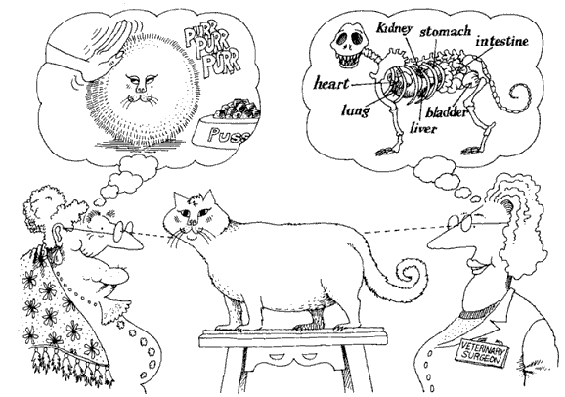
Abstraction
Abstraction focuses upon the essential characteristics of some object, relative to the perspective of the viewer
Notes:
An abstraction denotes the essential characteristics of an object that distinguish it from all other kinds of objects and thus provide crisply defined conceptual boundaries, relative to the perspective of the viewer

Slide 17
Abstraction Example
What do you gather from the following examples of air conditioner classes? Which one is the correct abstraction?
class AC
{
public:
void SwitchOn() ;
void Compress() ;
void DissipateHeat() ;
void SetFanRPM(int rpm) ;
void MoveFins(float angle) ;
void SenseRoomTemp() ;
} ;
enum Speed {low, med, high} ;
class AC
{
public:
void SwitchOn() ;
void SwitchOff() ;
void SetTemperature(float temp) ;
void SetFanSpeed(Speed s) ;
} ;
Notes:
In the above abstractions of an air-conditioner, which one is the correct abstraction? Which one would an AC mechanic use? Which one would a normal user use?
Abstraction depends on the perspective(domain) of the user. Only those persons can do abstractions who have the correct domain knowledge. So domain knowledge is very essential for abstraction.

Slide 18
Discussion
Representation of real-life objects as software entities
Unnecessary details are left out as the focus is only on elements that are valid in the current problem domain
Easy to model a solution for a problem
A class/structure/interface is an abstraction

Slide 19

Abstraction Example
Requirements
Perform operations on the academic record of the students. e.g. total/average marks, grade, etc.

Slide 20
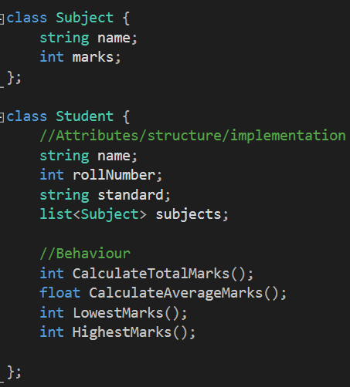
Example
Contains only those attributes and behaviours that are necessary for the school.
Height, gender, food habits, etc. are not required (even though every student has these attributes)

Slide 21
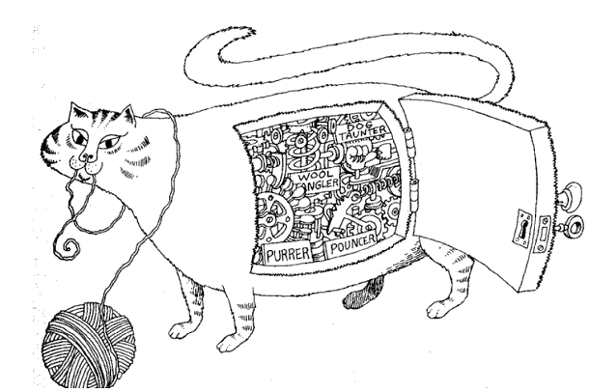
Encapsulation
Encapsulation hides the internal details of an object
Notes:
Encapsulation is the process of compartmentalizing the elements of an abstraction that constitute its structure and behavior; encapsulation serves to separate the contractual interface of an abstraction and its implementation
Abstraction & encapsulation are complementary concepts. Abstraction focuses upon behavior of an object, whereas encapsulation focuses upon the implementation that gives rise to this behavior.
Liskov says “for abstraction to work, implementations must be encapsulated”. This means that a class must have two parts: an interface and an implementation. The interface of a class captures only its outside view, encompassing our abstraction of the behavior common to all the instances of the class. The implementation of a class comprises the representation of the abstraction as well as the mechanisms that achieve the desired behavior.

Slide 22
Discussion
Avoids nasty bugs due to modifications to internal state of the object
Only the object itself should modify its state. Encapsulation enforces this concept.
Reduces dependency on implementation details of an object
Easy to change the implementation without affecting users

Slide 23
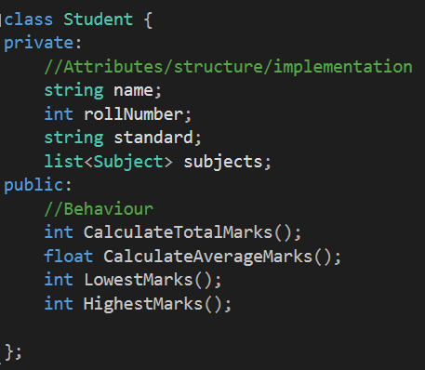
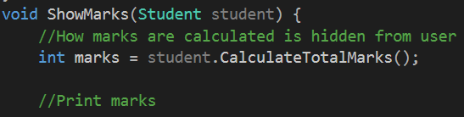
Example

Slide 24
Hierarchy
Hierarchy is a ranking or ordering of abstractions
Hierarchy is the natural successor of abstraction
Complexity can be further reduced by classification of objects. This forms a hierarchy and by identifying these hierarchies in our design, the problem at hand is greatly simplified
The most important hierarchies in a complex system are its class structure (“is a” relationship) and its object structure(“part of”)

Slide 25
Inheritance
Inheritance is a common technique for reusing functionality in OO systems
Often known as white-box reuse
It refers to visibility
the internals of the parent classes are visible to subclasses
Defined statically at compile time
Easy and straightforward to use
The implementation of the parent class can be easily modified by overriding

Slide 26
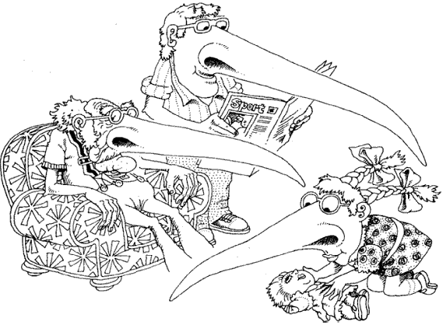
Inheritance
In “is a” relationship, a subclass will inherit the structure & behavior of its superclass
Notes:
Consider different sorting algorithms. The behavior is same for all the algorithms, so this behavior can be standardized in a class called as SortingAlgorithm. This class can have a method called as Sort. All the other sorting algorithm classes can inherit from this class and provide a specialized behavior of sort algorithm. This asserts “is a” relationship.

Slide 27
Hierarchy: "is a" Relationship
“is a” Relationship
Language
Program()
C++
Java
C#
Program()
Program()
Program()

Slide 28
Discussion
Helps in classification of objects based on their behaviour and implementation
Enables reuse of existing code, thus avoiding code duplication
Organizes the complexity and breaks it down into manageable chunks

Slide 29
Inheritance
When using inheritance incorrectly,
you can’t change the implementations inherited from the parent at run-time
a subclass is exposed to details of its parent’s implementation, so “inheritance breaks encapsulation”.
the implementation of a subclass become tightly coupled with its parent’s implementation
any change in the parent class will force the subclass to change
This creates a dependency which limits flexibility and ultimately, reusability.
Notes:
Another example can be of a Stack inheriting from an Array. You can implement push and pop by calling Array’s methods. But what would happen if the user calls clear() method of Array which is inherited into the Stack class? The Stack would be in an undefined state.

Slide 30
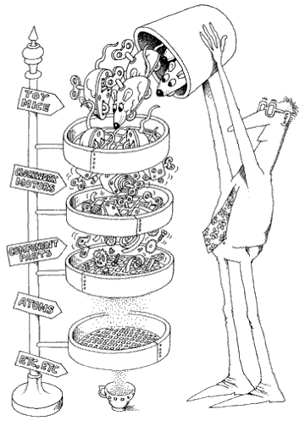
Composition
Abstractions form a hierarchy. In this example, the toy mice are composed of other objects and signifies “part of” relationship
Notes:
Example of “part of” relationship is a Window that contains a button or a classroom that contains students. Here the question of ownership is raised. In aggregation relationship, the inner object’s lifetime is not necessarily controlled by the outer object. For example, if the classroom is destroyed, the students will not be destroyed; instead they might become a part of other classroom.
Containment suggests strong relationship in which the lifetimes of the objects are intertwined together. When the outer object is destroyed, the inner object is automatically destroyed e.g. a window having a button.

Slide 31
Hierarchy: "part of" Relationship
“part of” Relationship
Window
Button
Show()
Destroy()
OnClick()
Containment
Classroom
Student
Train()
Learn()
Aggregation

Slide 32
Composition
Object composition is another form of reuse
New functionality is obtained by assembling or composing objects to get more complex system
Known as “black-box reuse”, because no internal details of the objects are visible
Composition can be defined dynamically at runtime through references or pointers to other objects
Objects are accessed solely through their interfaces that reduces dependencies
Any object can be replaced at runtime by another as long as they are of the same type.

Slide 33
Composition
With composition
classes are kept encapsulated and are focused on one task unlike inheritance
class hierarchies remain small and objects are light-weight
OO systems will have more objects and the system’s behavior will depend on their interrelationships instead of being defined in one class
But composition cannot be effectively used without inheritance
Inheritance and composition thus work together in a well designed OO system

Slide 34
How to use inheritance?
Use inheritance
for representing common behavior
substitutability
overriding/polymorphism
Avoid
using inheritance for inheriting implementation
inheriting from concrete classes
Ensure the hierarchy satisfies “is a” rule (use LSP)

Slide 35
Composition Vs. Inheritance
Favor composition over inheritance
Disadvantages of improper inheritance
defined statically at compile time
inheritance breaks encapsulation
dependencies are created
Composition has several advantages over inheritance
can be defined dynamically at runtime
does not break encapsulation
loose coupling between container and contained objects

Slide 36
Polymorphism
A single name may denote an operation
Several objects implement the same operation differently
These objects are related through some parent
Through parent, the operation can be called on any object through the common name
Consequently, we get different implementations through the same name (polymorphic behavior)

Slide 37
Polymorphism
OO languages support polymorphism in many ways
Through compile time polymorphism or parametric polymorphism
types are resolved at compile time (overloading, templates)
dynamic polymorphism
types are resolved at runtime (virtual mechanism)
Notes:
Compile time polymorphism can be achieved through function overloading or function templates in C++. In the first case, it is called as parametric polymorphism because the type of function to call is determined by examination of the parameters of the function call.
Following is an example of compile time polymorphism
#include <iostream>
using namespace std ;
class Rectangle
{
public:
void Draw()
{
cout << "Rectangle::Draw" << endl;
}
} ;
class Line
{
public:
void Draw()
{
cout << "Line::Draw" << endl;
}
} ;
template<typename Shape>
void DrawShape(Shape & shape)
{
for(int i = 0 ; i < 10 ; i++)
shape.Draw() ;
}
int main()
{
Rectangle r ;
Line l ;
DrawShape(r) ;
return 0 ;
}
Here the call to the Draw method is resolved at compile time, depending on the type of Shape.

Slide 38
Discussion
Promotes reuse
More classes can be added without requiring change to existing code
Certain implementations may not even require a recompilation of the binary
Works in tandem with composition and inheritance

Slide 39
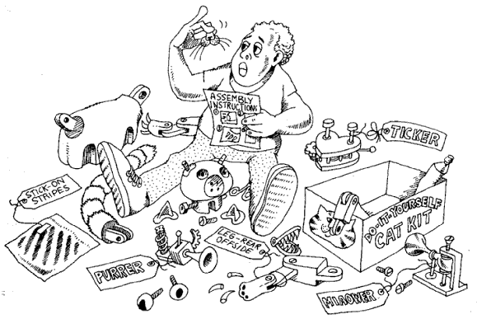
Modularity
Modularity packages abstractions into discrete units which are developed independently
Notes:
Modularity is the property of a system that has been decomposed into a set of cohesive and loosely coupled modules
Modularity is essential for managing complexity, especially in huge applications. An application can be developed in small modules, which can be compiled separately, but have connections with other modules.
Modularity is supported in diverse ways in different languages. In C++, a class declaration is placed in a header file & the definition in an implementation file(.cpp). Namespaces can be used to logically group related classes in one logical structure. Classes can also be placed in static or dynamic library. Dependency between the modules is then asserted with either #include preprocessor directive or the using directive. In Java, a program can be divided in package or assemblies in C#.
Classes for a small application can be put in the same library or namespace. But for big applications, it makes sense to have a logical division of related classes. Logical division can be through namespaces. Libraries can physically divide the classes into separate compilation units.
Sometimes, modularization is taken to extremes. Too much modularization is bad. Consider a windows GUI application. This application responds to several hundered messages. It would be unwise to create separate classes in separate modules for every message. This would be a poor design decision and would create maintenance nightmare.
Modularity results in reduction of the overall cost of the software, by allowing modules to be independently designed. However, the module should have a narrow interface so that it is possible to change the module without effecting other dependent modules.

Slide 40
Discussion
Manages complexity of writing large applications
Many teams can work on one application
Ease of reuse

Slide 41
C++ Implementation of Object Model
An object of a class will occupy at least 1 byte in memory
All member variables contribute to the memory requirements of the object
Member variables are laid out in the memory in the same order as they are declared by the user
Some features may cause the compiler to allocate more memory for implementing certain language features (e.g. virtual functions/inheritance, RTTI, etc)

Slide 42
OO Paradigm
Object oriented paradigm was thought to solve problems with procedural paradigm
But realization soon dawned that OOP does not work as promised
Hierarchy promised reuse & extensibility
Encapsulation promised safety of data
Designers began to face problems while designing the software using OO paradigm
Good designers solved the problems and documented them, so that same problems in future can be solved readily
This gave birth to design patterns - generic solutions to common problems encountered in object oriented software design
Notes:
asus rtl12+

Slide 43
What is a pattern?
Keyword coined by Christopher Alexander.
he noticed several buildings were constructed with a common pattern
Each pattern describes a problem which occurs over and over again in our environment, and then describes the core of the solution to that problem, in such a way that you can use this solution a million times over, without ever doing it the same way twice
Notes:
A pattern is just a way of sharing knowledge, experience. It isn't a solution in itself. It’s defined as “a proven solution for a recurring design problem that occurs within a context”. Please pay attention to the definition. The proposed solution can have different implementation alternatives, depending on the programming language or specific platform. For example, the J2EE design patterns propose a solution and implementation alternatives that may be suitable depending on what you are doing. However, the most important thing about a pattern is to understand what kind of problem solves, and that is why you should understand the problem context. Patterns are popular because they are a very good way to use a common language, to document a system and to reuse some parts of a system design. Contrary to popular belief, it's very hard to reuse existing domain objects (see the "Object-oriented Code Re-use myth") but patterns are very easy to reuse across different projects. On the other hand, a framework is a finite solution that helps you structure your code and solve a particular kind of problem. It is defined as "a partially built subsystem, for solving a specific problem and that must be instantiated for its usage". Every framework provides the basic building blocks for building your own systems according to your needs. These building blocks will be general for every problem, for example, reusable components that are ready to use [off the shelf components], interfaces that define design contracts and horizontal services. What you have to add to the framework is what is particular to your need (that is the framework instantiation). A framework may or may not be made with several patterns implementation. A framework is based upon the IoC (Inversion of Control) principle; your application just need to provide and declare some callback functions and start the framework. From there the framework is in charge of running the application, calling your callback functions whenever it's necessary. So as you can see, they are very different concepts, the main difference being that a framework is a physical and usable piece of code while a pattern is a logical design solution to a given kind of problem. I will add that every framework has its own purpose, best-practices, restrictions and limitations, and PLEASE READ THEM CAREFULLY AND GET EXPERIENCE APPLYING THEM. By experience, some frameworks are used for making things or solving needs, they were not designed for and so, users start having problems instead of getting the real benefits of using a proven, mature framework. Please also, pay attention to the maturity state of a framework. If a framework has been proven in several projects, it will do what you are expecting with high-quality, and what is more, it will evolve with its width customers using it. Another important noteworthy point is difference between API or Class Libraries and Framework. API is used for code reusability. Design patterns are used to build different parts of the frameworks. Every framework mostly has two parts: Frozen Spots and Hot Spots. Frozen Spots are designed using White Box framework. Pluggable parts of the framework are example of Hot Spots. If hot Spots are implemented as a framework, then it is called Black Box framework. There are several frameworks, some can be conceptual others can be technological, there is no restriction, they all bring building blocks, for making your own systems, faster, easier and reusing best practices of a proven common infrastructure. To name a few technical frameworks: - Struts (http://struts.apache.org/) and JSF – Java Server Faces are frameworks for building Web Interfaces. They both use the MVC design pattern, which is maybe the most used architectural pattern for building frameworks and software intensive systems. Design patterns related with MVC are: PAC Pattern and IoC. - Toplink (www.oracle.com/technology/products/ias/toplink/) and Hybernate are frameworks for object persistence. - Log4J (http://logging.apache.org/log4j/docs/) is a framework for auditory. You can use Log4J for implementing technical logs and business audit logs. - J2EE its framework for building Enterprise Applications. Its building blocks are horizontal services that provide common infrastructure and well defined interfaces in its specifications (Servlets, EJBs, JDBC, JMS, JTA among others) for building your own applications. - LEAF - Lucasian Enterprise Application Framework (http://www.lucasian.com/framework) is a white-box framework for building Enterprise Java Applications with high productivity in development and robustness in production environments. LEAF is built on top of the J2EE Design Patterns framework and open-source frameworks such as, Log4J, Apache Axis and Jelly. LEAF provides common horizontal services for security, auditory and frameworks for concurrency, exceptions handling and QoS. LEAF is white-box framework because it provides code generation wizards through an Eclipse Plug-In that will generate specific application components using J2EE Design Patterns (Data Access Objects with the Abstract Factory Pattern, Value Objects, Composite Entity, Data Transfer Objects, EJB Façade, Read-Only Entities, and Business Delegates among other supported design patterns). White box means that you can see, change, extend and debug your own Java code instead of having interpreters or any kind of black-box engine, with dependency on vendor specific design patterns or infrastructure. The list is endless; however think about a framework as a partially built solution, built on top of design patterns, that imposes patterns for solving specific problems. In order to use the frameworks for building your own needs rapidly and with low risk, you should use its basic building blocks (reusable services, components, design principles, extensibility mechanisms) and understand its usage best practices and limitations.
Patterns do not always give perfect solutions. Because patterns represent the collective experience of many designers over the years, however, they are often better than the solutions you or I might come up with on our own in the often limited time we have

Slide 44
Doors Example
Problem: "How do you place doors in a room?
BANG !
“If the doors create a pattern of movement which destroys the places in a room, the room will never allow the people to be comfortable”

Slide 45
Solution
Solution: “...in most rooms, especially small ones, put the doors as near the corners of the room as possible”.
“If a room has two doors, and people move through it, keep both doors at one end of the room”
Untouched by movement

Slide 46
Software Patterns
In software, “design patterns are language & domain independent strategies for solving common object-oriented design problems”. The proposed solution can have different implementation alternatives, depending on the programming language or specific platform

Slide 47
Importance?
Design Patterns are solutions to common and recurring design problems
Readily available solution
Save time
Can be integrated in existing code
Independent of language

Slide 48
Describing Design Patterns
Design patterns are described using a consistent format and each pattern is divided into sections
These sections are based on a template. This template gives a uniform structure to the pattern and makes it easy to learn and apply
Examples are also provided to help you see the design in action. Most of the examples are in C++

Slide 49
Pattern Template
Name | All patterns have a unique name that identifies them
Intent | The purpose of the pattern
Applicability | Situations in which the design pattern can be applied
Structure | A graphical representation of the classes in the pattern
Motivation | A scenario that illustrates a design problem and how the class and object structures in the pattern solve the problem
Participants | The entities involved in the pattern.
Consequences | The consequences of using the pattern. Investigates the forces at play in the pattern.
Implementation | How the pattern can be implemented.

Slide 50
Organizing Design Patterns
Design patterns are organized based on two criteria
Purpose : Reflects what a pattern does. Can be of following types
Creational – object creation
Structural – deal with class & object structures
Behavioral – interaction between classes or objects
Scope : Specifies whether the pattern applies primarily to classes or to objects. Class patterns deal with relationships between classes and their derivatives. Object patterns deal with object relationships which can be changed at runtime
Notes:
In class patterns, the relationship is based on inheritance and is established at compile time, so they are static. But object patterns are dynamic and can be changed at runtime.
But almost all patterns use inheritance to some extent. But most of the patterns are in object scope

Slide 51
Creational Patterns
Creational patterns encapsulate the instantiation process. This helps to make a system independent of how the objects are created, composed & represented
Creational patterns have two advantages – they encapsulate concrete classes from the client, and they hide the knowledge of how the instances of the classes are put together
The system only knows about the abstract interfaces of the object. Consequently, you get greater flexibility in what gets created, who creates it, how it gets created and when

Slide 52
Factory Method
Define an interface for creating an object, but let subclasses decide which class to instantiate. Factory method lets class defer instantiation to subclasses
Factory method is used to decouple the clients from the concrete classes they instantiate and encapsulates creation
Factory Method relies on inheritance; object creation is delegated to subclasses which implement the factory method to create objects
Factory Method is also called as virtual constructor

Slide 53
Structure
Creator
Product
FactoryMethod()
AnOperation()
…
product=FactoryMethod()
…
ConcreteProduct
ConcreteCreator
FactoryMethod()
return new ConcreteProduct
Notes:
In AnOperation, you can do some default processing after creating the objects. For example, you could generate Employee IDs of those employees who are permanent

Slide 54
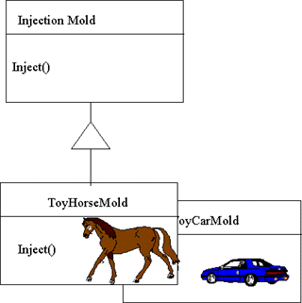
Non-software Example
Notes:
Manufacturers of plastic toys process plastic molding powder & inject the plastic into molds of desired shapes

Slide 55
Implementation
Factory method can have one of the several implementations depending on the type of problem
Make the Creator as an abstract class and do not provide an implementation for the factory method it declares
Make the Creator as a concrete class and provide a default implementation for the Factory method
Use parameterized factory method to create multiple kinds of products
make the factory method as an instance member
make the factory method as a static member (but you lose the power of polymorphism)
Templates can also be used to avoid subclassing every time to create a new product(Used extensively in ATL COM)
It is a good practice to use naming conventions that make it clear that you’re using Factory methods

Slide 56
Advantages
Promote loose coupling
No need to deal with concrete classes directly
Encapsulate creation
prevent unauthorized creation
Behaves like a virtual constructor
instance is created virtually
Factory methods may not create a new object upon each invocation
objects can be cached and reused, if necessary

Slide 57
Disadvantages
May lead to large number of classes in an application

Slide 58
Applicability
Use the Factory Method pattern when
a class doesn’t know which instance it requires until runtime
a class wants its subclasses to specify the objects it creates
you want to control the instantiation process of a class
object instance has to be initialized with some data not available to the client
a client needs a flexible way of creating the object (named constructor)
Notes:
class Car
{
Car(name, top speed)
CreateFerrari()
CreatePorsche()
CreateBMW()
} ;

Slide 59
Known Uses
Factory methods are mostly used in toolkits and frameworks
COM contains an interface IClassFactory that has a method called CreateInstance()
In STL, you get the instance of a particular iterator through begin() & end()
In C#, the Array class implements a static factory called as CreateInstance()
In C#, DbCommand class contains a method called ExecuteReader() that returns an instance of a Datareader that is used to traverse the rows of a table
In Java, SAXParserFactory is used to return a SAXParser to parse XML documents.
In Java, ContentHandlerFactory returns instance of a ContentHandler subclass to handle specific content from URLConnection
Notes:
LogManager.getLogManager, Calendar.getInstance, Collections.unmodifiableCollection, Collections.synchronizeCollection are examples of factories

Slide 60
Singleton Pattern
Ensure a class only has one instance, and provide a global point of access to it
A singleton class has one and only one instance
Useful when an object should have only one instance
database connection, a random number generator or even a factory
Globally accessible

Slide 61
Structure
Singleton
static Instance()
SingletonOperation()
GetSingletonData()
return uniqueInstance
static uniqueInstance
singletonData

Slide 62
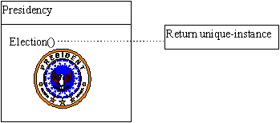
Non-software Example
Notes:
The office of the President of the United States is a Singleton. The United States Constitution specifies the means by which a president is elected, limits the term of office, and defines the order of succession. As a result, there can be at most one active president at any given time. Regardless of the personal identity of the active president, the title, "The President of the United States" is a global point of access that identifies the person in the office

Slide 63
Implementation
Usually implemented through static methods.
returns the instance of the class
This instance could be
eagerly created instance (always thread-safe)
lazily created instance (not thread-safe)
Lazily created instance can be made thread-safe through double-checked locking pattern
Can also be implemented by creating a registry of singletons
Notes:
When the Singleton class is implemented through a static pointer, you have to decide when to free it. You have the following options:
Write a function that the clients can call to delete the instance (But this could leave other clients with dangling pointers)
Make the instance of the Singleton class as a static member of the class itself. This way it would get destroyed automatically after main() returns (What if the class is dependent on arguments that can be passed only at runtime? What if the object creation is expensive?)
Declare the instance of Singleton class globally (We can’t guarantee that only one instance will be created. Also C++ doesn’t define the order in which the constructors of global objects are called across translation units. This means that no dependencies can exit between Singletons, if any do, they can cause errors)
If the Singleton class requires arguments at runtime and it has to be deleted only after main() returns, then you can create a separate class that
will have the responsibility of just destroying the Singleton instance as follows:
class SingletonDestroyer
{
Connection *m_pConnection ;
public:
SingletonDestroyer(Connection *p= NULL):m_pConnection(p){}
void SetSingleton(Connection *p){m_pConnection = p ; }
~SingletonDestroyer() ;
} ;
std::auto_ptr can also be used. This can be made as the static member of the Singleton class itself. Attach the address of the object to the smart pointer. After main() returns, the singleton instance will automatically get destroyed
You can also use C atexit() function from cstdlib file.

Slide 64
C++ Implementation
Freeing the memory of a lazily created instance is an issue
who will free the memory
Possible through
atexit() function
using static instance of another class (usually a smart pointer)
May not work always
order of static initialization & destruction is not specified in the C++ standard
Use std::call_once as alternative to double checked locking
Use Meyer’s singleton if using C++11

Slide 65
Using CRTP
CRTP idiom can be used to make any class singleton
Involves writing a class template that acts as a base class
The child class inherits from base, while making it a friend (so that the base can access the private constructor of the child)
Notes:
Curiously Recurring Template Pattern

Slide 66
Java Implementation
Eagerly created instances could be garbage collected in JDK 1.2 versions & below due to a bug in the garbage collector
Use of volatile in double-checked locking had a bug in JDK versions prior to 1.5 and may not work
Use Bill Pugh’s solution

Slide 67
Intialization-on-Demand Holder Idiom
Suggested by Bill Pugh
This idiom gives the flexibility of serial creation with lazy initialization
Implemented through a nested static class in Java
The instance is created only when the instance creation method is invoked
Useful in JDK versions that do not have correct implementation of volatile keyword (and DCLP cannot be used safely)
works in all versions of Java

Slide 68
Alternative Implementation
An alternative to Singleton is Monostate pattern
Singular behavior is enforced through behavior rather than structure
All the attributes are made static
Clients may create any number of instances, but all the instances will share the same data

Slide 69
Advantages
Singleton class has strict control over its instance creation
may deny creation based on some rules
may be configured to create a fixed set of instances (multiton) later
More flexible than Monostate (monostates cannot be polymorphic)
Better than global variables that store single state
A singleton can be sub classed

Slide 70
Disadvantages
Difficult to code in multithreaded environment
DCLP does not always work
Bugs in older Java implementations make it harder to implement Singleton
Multiple class loaders/runtimes will lead to multiple instances of the class
C++ implementation is difficult when lazily created instance is used

Slide 71
Applicability
Use the Singleton pattern when
exactly one instance of a class is required, and it must be accessible to clients from a well-known access point
you have a class whose objects are intended to be used as read-only
a class has no state and you don’t want to create lots of stateless objects

Slide 72
Known uses
In COM, all the factory classes are singletons
The application object in many GUI frameworks are singletons (MFC, Android, iOS, etc)
.NET applications also have a single instance of the Application class that can be accessed from anywhere in the application
Java has several singletons in its framework. e.g. java.util.logging.Logger, java.awt.ToolKit, etc

Slide 73
Structural Patterns
Structural patterns use class inheritance & object composition to form larger structures
Structural class patterns use inheritance to compose interfaces or implementations. A simple example would be a class inheriting from two base classes
In structural object patterns, objects are composed to realize new functionality. An advantage over class patterns is that new functionality can be added dynamically at runtime

Slide 74
Adapter Pattern
Convert the interface of a class into another interface clients expect. Adapter lets classes work together that couldn’t otherwise because of incompatible interfaces
Used for interface conversion
New code may use a legacy component that has a different interface
adapters help in reuse
Also known as wrapper
Adapters can be created as object adapters or class adapters

Slide 75
Object Adapter
Client
Target
Adaptee
Request()
SpecificRequest()
Adapter
adaptee
Request()
adaptee->SpecificRequest()

Slide 76
Class Adapter
Client
Target
Adaptee
Request()
SpecificRequest()
(implementation)
Adapter
Request()
SpecificRequest()

Slide 77
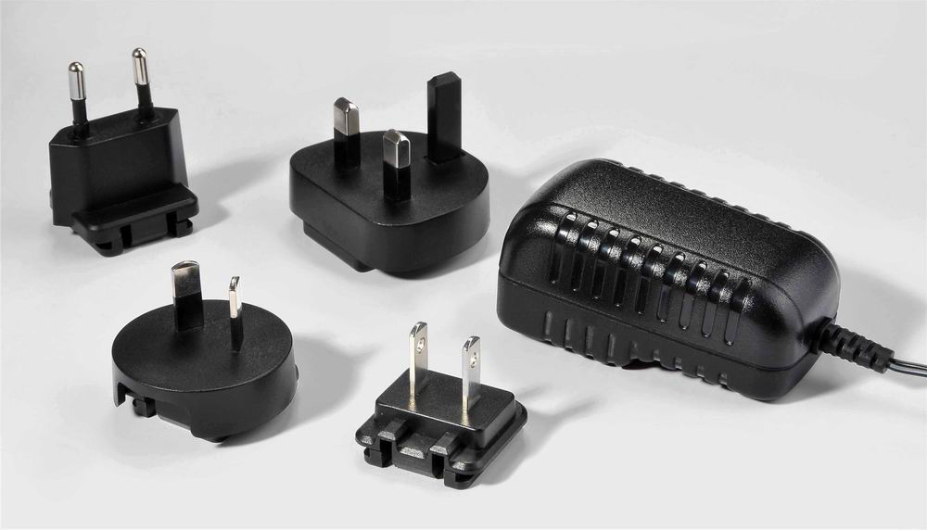
Non-Software Example

Slide 78
Implementation
Can be implemented either through composition or inheritance
Object adapter uses composition
adapter composes the adaptee and calls its methods through the reference/pointer indirection
Class adapter uses inheritance
adapter inherits from the adaptee
Adapters may only convert the interfaces or also support other processing along with interface conversion

Slide 79
C++ Implementation
Implementing class adapter may not always be possible in all the languages (Java & C#)
especially when adapter is already inheriting from a class
In C++, the adapter can inherit privately from the adaptee, so that its methods are not visible to the adapter’s clients

Slide 80
Advantages
A class adapter
uses the Adaptee directly by calling the inherited methods
can override Adaptee’s behavior
there is no additional pointer indirection
An object adapter
lets a single Adapter work with many Adaptees
can always adapt to an existing class

Slide 81
Disadvantages
Class adapter
cannot be used if subclasses of adaptee have to be used as well
not possible in all languages
Object adapter
cannot override adaptee’s behavior

Slide 82
Applicability
Use when
you want to use an existing class, and it has an incompatible interface
you want to create a reusable class that cooperates with unrelated or unforeseen classes, which don’t have compatible interfaces
(object adapter) you need to use classes from an existing hierarchy
(class adapter) you need to modify some behavior of the adaptee

Slide 83
Known Uses
Binders in STL can convert a binary function into a unary function
In STL, std::stack class uses a std::deque internally for data storage and provides a simplified interface to the user to access it
JNI enables you to access C/C++ code from Java
In Java, ParserAdapter can convert a SAX1 Parser into SAX2 XMLReader
XMLReaderAdapter wraps XMLReader and makes it act like a SAX1 Parser

Slide 84
Façade Pattern
Provide a unified interface to a set of interfaces in a subsystem. Façade defines a higher-level interface that makes the subsystem easier to use
Provide a simplified interface to the functionality of a complex subsystem
The subsystem classes still remain available to direct use by the clients
Facades generally don’t “encapsulate” the subsystem classes
A Façade might pass a client request directly to the subsystem or add some extra functionality
Similar to an Adapter, but the difference is that Adapter alters an interface that matches one the client expects and Façade provides a simplified interface for the client
client can still access the subsystem classes in Façade, but not in Adapter
Notes:
Provide a unified interface to a set of interfaces in a subsystem. Façade defines a higher-level interface that makes the subsystem easier to use
A Façade provides a single, simplified interface to the more general facilities of a subsystem
In the above example, different clients are using the services of the compiler directly. Most of the clients of the compiler won’t really care about the details of parsing & code generation; they just want to compile some code. They don’t require the powerful but low-level interfaces in the compiler and it only complicates their tasks
To shield the clients from these low-level classes, the compiler subsystem contains a Compiler class. This class defines a unified interface to the compilers functionality and acts as a façade. Note that, it does not hide the subsystem classes directly. Clients that need to work with the low-level classes can still use them.

Slide 85
Structure
Façade
subsystem classes
Notes:
The Principle of Least Knowledge guides us to reduce the interactions between objects to just a few close “friends”.
Principle of Least Knowledge – talk only to your immediate friends
When designing a system, for any object, be careful of the number of classes it interacts with and also how it comes to interact with those classes
This principle prevents us from creating design that has a large number of classes coupled together. If changes are made to one part, the other parts would automatically get affected. If there are too many dependencies, the whole system would become fragile and costly to maintain

Slide 86
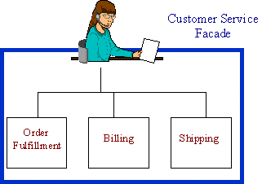
Non-software Example
Notes:
The Facade defines a unified, higher level interface to a subsystem, that makes it easier to use. Consumers encounter a Facade when ordering from a catalog. The consumer calls one number and speaks with a customer service representative. The customer service representative acts as a Facade, providing an interface to the order fulfillment department, the billing department, and the shipping department.
Templates or wizards act as facades while creating a new document

Slide 87
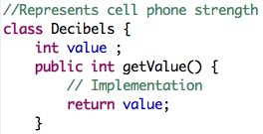
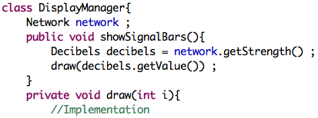
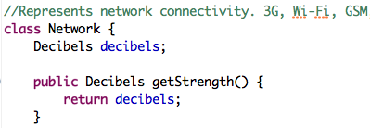
Dependencies
Dependency

Slide 88
Principle of Least Knowledge
Façade is a classical example of Principle of Least Knowledge (alias Law Of Demeter)
talk only to your immediate friends
Suggests that you reduce the number of classes your object interacts with
Leads to flexible design as objects are loosely coupled
Otherwise, lots of dependencies will be created between objects
Leads to a fragile system that breaks often and is costly to maintain

Slide 89
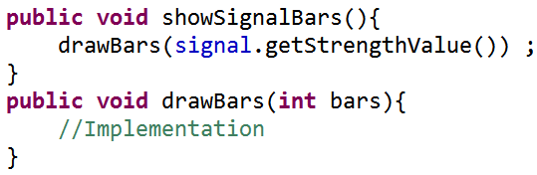
Principle of Least Knowledge
Any object should only invoke methods that belong to
the object itself
objects passed in as a parameter to the method
any object the method creates or instantiates
any components(contained objects) of the object
With Principle of Least Knowledge
Notes:
Avoid calling methods on an object that we get from another method call. This way, your object gets tightly coupled with this object as well and you are talking to strangers (increased dependency)
Applying this principle leads us to ask the object to make the request for us; this way we don’t have to know about its component objects(and we keep our circle of friends small)
e.g.
Without Principle Of Least Knowledge
const std::string &getName()
{
//Our class gets coupled with Employee class, thus increasing the dependency
const Employee &emp = employeeCollection.getEmployee(1234) ;
return emp.getName() ;
}
With Principle Of Least Knowledge
const std::string &getName()
{ return employeeCollection.getNameOf(1234) ;
}

Slide 90
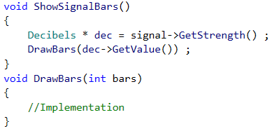
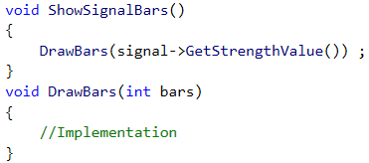
Principle of Least Knowledge
Any object should only invoke methods that belong to
the object itself
objects passed in as a parameter to the method
any object the method creates or instantiates
any components(contained objects) of the object
Without Principle of Least Knowledge
With Principle of Least Knowledge
Notes:
Avoid calling methods on an object that we get from another method call. This way, your object gets tightly coupled with this object as well and you are talking to strangers (increased dependency)
Applying this principle leads us to ask the object to make the request for us; this way we don’t have to know about its component objects(and we keep our circle of friends small)
e.g.
Without Principle Of Least Knowledge
const std::string &getName()
{
//Our class gets coupled with Employee class, thus increasing the dependency
const Employee &emp = employeeCollection.getEmployee(1234) ;
return emp.getName() ;
}
With Principle Of Least Knowledge
const std::string &getName()
{ return employeeCollection.getNameOf(1234) ;
}

Slide 91
Implementation
A Façade can be a class or a set of classes
Façade can be an abstract class with concrete subclasses for different implementations of the subsystem
The coupling between the clients and the subsystem can be further reduced
Often implemented as Singletons
Can be implemented as transparent or opaque facade
Notes:
Transparent facades are optional; users can still access the subsystem classes directly
Opaque facades, on the other hand, do not allow the clients to access the subsystem classes directly

Slide 92
Advantages
Façade isolates the clients from complex subsystem classes
reduces the number of objects the clients interact with
reduces compilation dependencies in large systems
There is a weak coupling between the clients and the subsystem.
the subsystem components can vary without causing the clients change
Façade does not prevent applications from using subsystem classes if they need to
Provides an Object Oriented interface to low-level functions & data structures, thereby reducing programming errors (MFC, ACE, etc)

Slide 93
Disadvantages
Overuse leads to too many layers
impacts the performance of the system
choice between flexibility & speed

Slide 94
Applicability
When you want to provide a simple interface to a complex system
A system has evolved and gets more complex
early users might want to retain their views of the system
Team members with different level of experience use the system
you might want to provide novice or power user interfaces
Too many dependencies between clients and the implementation classes of a subsystem
Notes:
clients make a lot of network calls to different parts of a service and you want to reduce the number of calls and also provide a simple interface
you want to layer your subsystems for simplicity

Slide 95
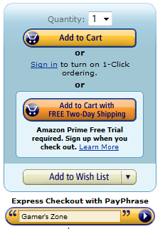
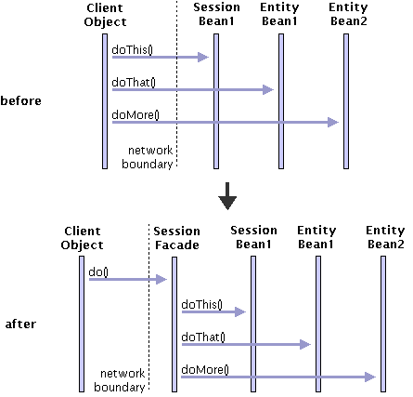
Known Uses
Façade is used extensively in J2EE as a session manager
Libraries like MFC, ACE, and Boost encapsulate native OS C APIs, such as sockets, pthreads, or GUI functions and provide an easy interface to such APIs
Notes:
A component called session façade manages the interactions between the client and the business components. This leads to lower network traffic and fewer dependencies on the components

Slide 96
Adapter & Facade
Adapter converts an incompatible interface into a required one
Clients cannot directly access the underlying class
Adapter might perform some work before and after the actual class is used
Façade provides a simplified interface to a system
Clients can still access the underlying modules directly
Façade usually does not perform any processing before delegating the call to the subsystem (depends on the required functionality)

Slide 97
Proxy
A person having a bank account never interacts with the account physically. If he wants to withdraw money, he can use an ATM card or a cheque
The ATM or cheque act as representatives of the account. They can be called as proxies
A proxy is an object that represents another object. There can be several reasons for using a proxy to access the real object
In OO programming, a proxy is required to control access to the real object
Notes:
Proxy can be required

Slide 98
Proxy Pattern
Provide a surrogate or placeholder for another object to control access to it
Proxy is used whenever the real object may not be accessed directly
e.g. loading a document with lots of images
desirable to load images only when they are required
To save memory, the images are represented by proxies (default images)that act as substitutes for real images
Proxy is also known as a surrogate

Slide 99
Structure
Client
Subject
Request()
…
RealSubject
Proxy
Request()
…
Request()
…
realSubject->Request() ;

Slide 100
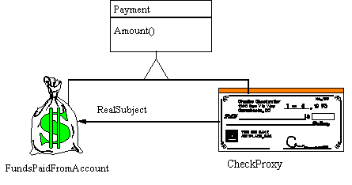
Non-software Examples
Notes:
The Proxy provides a surrogate or place holder to provide access to an object. A check or bank draft or ATM card is a proxy for funds in an account. A check can be used in place of cash for making purchases and ultimately controls access to cash in the issuer's account.

Slide 101
Implementation
Proxies have the same interface as that of the real object
client won’t know the difference between proxy & the real object
Proxies may internally create the instance of the real object
One proxy can be used to work with many real objects through an abstract interface
Proxy can be created by overloading -> & * operators in C++

Slide 102
Advantages
Proxy introduces a level of indirection (which can be useful)
The real object can be hidden from the client
Remote proxy can hide the real object from the user
Virtual proxy can create objects on demand
Protection proxy limits access to the object
obtaining locks & permissions or giving restricted access
Cache proxy can reduce expensive calls
Smart pointers help in automatic resource management in C++

Slide 103
Disadvantages
Tight couplings between the proxy & the real subject
especially if the object is being created on demand

Slide 104
Applicability
Use when access to real object may not be feasible
a remote component has to be used
an expensive object has to be created on demand
access to the original object has to be restricted
automatic memory management (in C++) by overloading operators
caching frequent requests

Slide 105
Known Uses
In C++, a simple pointer can be automatically freed by using a smart pointer, such as shared_ptr<T>
COM provides CComPtr<T> that manages reference counts and automatically destroys the component
When using a remote COM component, the client communicates through a proxy that takes care of marshalling the data and sending it to the actual component. Such proxies are created through IDL files
Web services provide WSDL files for creating proxies

Slide 106
Decorator
Attach additional responsibilities to an object dynamically. Decorators provide a flexible alternative to subclassing for extending functionality
This pattern helps in adding more responsibilities to an object
alternative to inheritance
Can be used when there can be a variety of optional operations that can precede or follow another function that is always executed
Decorator is also known as the wrapper

Slide 107
Structure
Component
Operation()
component
ConcreteComponent
Decorator
Operation()
Operation()
component->Operation();
component->Operation()
ConcreteDecoratorA
ConcreteDecoratorB
Operation()
Operation()
AddedBehaviour()
Decorator::Operation();
AddedBehaviour();
Decorator::Operation();
AddedBehaviour() ;
addedState

Slide 108
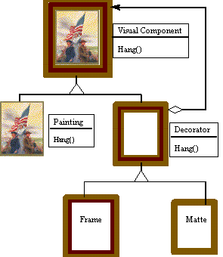
Non-software Example
Notes:
The Decorator attaches additional responsibilities to an object dynamically. Although paintings can be hung on a wall with or without frames, frames are often added, and it is the frame which is actually hung on the wall. Prior to hanging, the paintings may be matted and framed, with the painting, matting, and frame forming a single visual component.

Slide 109
Implementation
Every decorator’s interface must conform to the interface of the object it decorates
must inherit from common base class
Abstract decorator is not required if only one responsibility has to be added
the decorator can itself forward the calls to the object
Abstract Decorator & its base class should be lightweight
these objects are part of every decorator and will make the decorators bulky to use

Slide 110
Advantages
Flexible way of adding responsibilities to an object rather than inheritance
dynamic unlike inheritance
Features are added incrementally as the code progresses
no need to put every feature in one class
You pay for the features only when you use them
Easy to add a combination of capabilities
same capability can be added twice

Slide 111
Disadvantages
Lots of small objects are created
System becomes harder to understand & debug

Slide 112
Applicability
Responsibilities have to be added dynamically
Responsibilities have to be withdrawn
Subclassing through inheritance is impractical.
supporting combinations through inheritance is error-prone
Class is hidden or not available for subclassing. You want to add new features to such class

Slide 113
Known Uses
Decorators prevail the IO system in various frameworks
In MFC, you can decorate the CSocket class to support serialization through CSocketFile & CArchive class
.NET provides decorators like BufferedStream & CryptoStream that wrap the Stream class and provide additional functionality
Java provides BufferedInputStream & LineInputStream amongst other decorators that decorate FileInputStream class

Slide 114
Assignment
Design a Window class such that it can support dynamic addition of toolbars, status bars, menus, preview panes, etc. This Window class will be used in a GUI application and will represent a window. In future, we may want to add support for skinned windows as well (like WinAMP) that should also exhibit the same behavior of dynamic addition of the above mentioned UI elements

Slide 115
Bridge
Decouple an abstraction from its implementation so that the two can vary independently
This pattern separates the abstraction and its implementation (abstraction means the class and the implementation means the behavior of the class)
This helps us to reuse the same abstraction with different implementations which otherwise would require creating multiple classes
Also known as handle/body
Abstraction is called the handle and implementation is called the body

Slide 116
Structure
Structure
Client
Abstraction
Implementor
Operation()
OperationImp()
imp->OperationImp()
RefinedAbstration
ConcreteImplementorA
ConcreteImplementorB
OperationImp()
OperationImp()

Slide 117
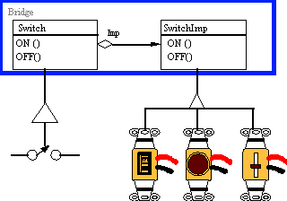
Non-software Example
Notes:
The Bridge pattern decouples an abstraction from its implementation, so that the two can vary independently. A household switch controlling lights, ceiling fans, etc. is an example of the Bridge. The purpose of the switch is to turn a device on or off. The actual switch can be implemented as a pull chain, a simple two position switch, or a variety of dimmer switches.

Slide 118
Implementation
Abstract Implementor class is not always necessary, especially if only one implementation exists. In such case, there will be a one-to-one relationship between Abstraction & Implementor (handle-body)
In C++, this pattern can be used to
hide a class from the clients and also to decrease the dependency of the code on the class, especially if it is changing often
share implementations across several objects
Notes:
You can also use multiple inheritance to bind an abstraction to its implementation. This can be done through multiple inheritance in C++, where the class can inherit publicly from abstraction and privately from implementation. But this will bind the abstraction permanently to the implementation

Slide 119
Advantages
Since, the implementation is not bound to an interface, it can be configured at run-time. The implementation can even be changed at runtime
You can extend the Abstraction & Implementor hierarchies independently
The implementation details can be hidden from the client e.g. you can implement sharing of implementor objects through reference counting mechanism

Slide 120
Applicability
Bridge pattern is applicable when
you want to avoid a permanent coupling between an abstraction and its implementation especially if the implementation has to be switched at runtime
both the abstractions and their implementations should be extensible by subclassing
changing the implementation of an abstraction should not impact the clients
you wish to hide the implementation of an abstraction completely from the clients (C++)
you want to share an implementation among multiple objects
you have a proliferation of classes due to different contexts

Slide 121
Known Uses
This pattern is frequently used in the form of handle-body idiom in C++. It is used to hide the implementation of a class from its user. It is also known as Cheshire cat
In MFC, the serialization part of the library uses the bridge pattern. The serialization part is handled by CArchive class(Abstraction) & the implementation is handled by CFile or CSocketFile (Implementors)

Slide 122
Behavioral Patterns
These patterns are concerned with the interactions between the objects.
The interactions are such that the objects can collaborate with each other, while at the same time, be loosely coupled, so that the objects can be changed at runtime

Slide 123
Model View Controller
Invented by Smalltalk programmers
Used by applications that present data to the user
Uses the principle of “separation of concerns”
Basically, the responsibility is divided into different components instead of being defined into one

Slide 124
Model View Controller
An application that presents data to the user has to handle the following tasks:
Take data from the user
Present data to the user
Save the data into a data store (e.g. database)
Implementing all functionality in one component will make the code complex and difficult to maintain
MVC suggests a design that breaks down the responsibilities into different components

Slide 125
MVC
MVC proposes three main components
Model : manages the behavior and data of the application and
responds to requests for information (usually from the view)
responds to instructions for change in state(usually from the controller)
View : manages the display of information
Controller : accepts input from the user and informs the model or view to change

Slide 126
MVC
Manager
Controller
Model
View
Data
Presentation

Slide 127
MVC Models
MVC has two variations
Passive Model : Here the controller manipulates the model exclusively and then informs the view about the change. The model is completely independent of the view
Active Model : This model is used when the model changes the state without controller’s involvement. The model may change from some other source and has to inform the view of the change

Slide 128
MVC Using Observer Pattern
Controller
<<interface>>
Observer
Model
View

Slide 129
MVC Variations
MVC is implemented in most of the frameworks that have to display data to the user
MFC uses a variation called Document-View architecture
Microsoft provides a framework called MVC for creating web applications and also has variations calls MVVM and MVP
Apple’s iOS SDK uses MVC for it’s GUI applications
Android also uses MVC for GUI applications

Slide 130
Observer Pattern
Define a one-to-many dependency between objects so that when one object changes state, all its dependents are notified and update automatically
Describes how to establish a one-to-many relationship
Key objects are subject and observer
one subject & many observers
all the observers are notified whenever the subject undergoes a change in state
Subject sends notifications without having to know who its observers are.
any number of observers can subscribe to receive notifications
Also known as publish-subscribe

Slide 131
Structure
observers
Observer
Subject
Update()
Attach(Observer)
Detach(Observer)
Notify()
for all o in observers{
o->Update()
}
ConcreteSubject
subject
ConcreteObserver
GetState()
SetState()
Update()
observerState=
subject->GetState()
return subjectState
observerState
subjectState

Slide 132
Implementation
The subjects keep track of their observers by keeping a reference of each
Array, List
An observer can depend on more than one subject.
Have the subject tell the observer who it is via updating interface
Update is triggered by the subject itself on a state-setting operation, observer or by the clients

Slide 133
Implementation
Observers can register for specific events only
more efficient as it avoid unnecessary updates
only those observers will be updated that are dependent on the data that has changed
Before the subject notifies its Observers, it should be in a consistent state
Use template method to avoid inconsistency

Slide 134
Push Model
The subject sends observers detailed information about the change
not efficient (for large data)
not all observers may require the data
difficult to generalize data for different types of observers
Better use a general type (Object, void *) as a hint for the type of data changed

Slide 135
Pull Model
Minimal information is sent to the observer
Observer asks for details explicitly thereafter
Can be used with all types of observers
It may be difficult for the observers to ascertain what data has changed

Slide 136
Language Specific Implementation
In C#, delegates & events can be used for notifying the observers
more aligned towards C# langauge
Java provides Observer interface & Observable class
provides the framework for registration, unregistration & notification
C++ - function pointers & function objects

Slide 137
Advantages
Minimal coupling between Subject and Observer
subjects can be reused without reusing their observers & vice versa
observers can be added without modifying the subject
subjects only need to know the update interface
subject & observer can belong to different layers
Support for broadcast communication
No need to specify the receiver of the notification. The notification is broadcast automatically to registered observers
subject is not dependent on observers, their number or what they do with the notification
Notes:
Subject has no idea of how many observers exist or what the observer does with the notification. This gives a complete freedom of adding and removing observers dynamically

Slide 138
Disadvantages
Observers don’t have any knowledge of each others presence.
Must be careful about triggering updates
Simple update interface makes it difficult for the observers to deduce changed item

Slide 139
Applicability
The Observer pattern can be used when
a change to one object requires changing others, and you don’t know how many objects need to be changed
an object should be able to notify other objects without depending on those objects
several objects should synchronize their state with other objects

Slide 140
Known Uses
Observer pattern is at the core of Model View Controller
Java provides Observable class & Observer interface as built-in support for observer pattern
In .NET, delegates and events can be used to trigger notifications
MFC uses Observer pattern in its Document View Architecture
QT & Boost can use signals & slots
In COM, connection points architecture is based on Observer pattern
Used extensively in web applications as a part of Model View Controller
Most of the applications with multiple views rely on Observer pattern to keep the views in sync with the data

Slide 141
Assignment
A company has a stock ticker that gives the quotes of the company on a LCD display every minute. Modify the ticker so that any employee can register to get the stock quote on his PC every minute. Every employee has a grade assigned to him & employees with grade greater than 10 (VPs, Directors, Stakeholders, etc), should additionally get a special notification if the quote goes below 50%. Also add the facility of logging the quotes to a log file or database

Slide 142
Mediator Pattern
Define an object that encapsulates how a set of objects interact. Mediator promotes loose coupling by keeping objects from referring to each other explicitly, and it lets you vary their interaction independently
In object-oriented design, we try to strive for distribution of behavior among objects
While this is helpful, in worst case, every object ends up knowing about every other
This increases coupling between the classes and makes the application monolithic

Slide 143
Mediator Pattern
Mediator relieves the objects from knowing each other explicitly
It will be responsible for controlling and coordinating the interactions of objects. This prevents the objects from referring to each other explicitly
Each object only knows the mediator, thus reducing the number of interconnections

Slide 144
Structure
mediator
Colleague
Mediator
ConcreteMediator
ConcreteColleague1
ConcreteColleague2

Slide 145
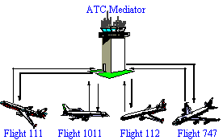
Non-software Example

Slide 146
Implementation
Usually, there is no need to define an abstract Mediator class.
required only if the colleagues need to work with different Mediators
Colleagues have to communicate with their mediator when an event of interest occurs.
can be implemented through observer pattern where the colleagues will act as publishers and mediator will act as subscriber.
The mediator will be responsible for taking action on the event and generating a response for other colleagues

Slide 147
Language Specific Implementation
Command pattern may help a colleague inform mediator to take action
In C++, this can also be achieved through templates
In C#, events can be used to inform the mediator
Java can use action listeners

Slide 148
Consequences
Mediator centralizes the behavior that otherwise would have been distributed among several objects. This behavior can be changed easily by subclassing the mediator
It promotes loose coupling between colleagues
Mediator replaces many-to-many interactions with one-to-many interaction which is easier to understand and maintain
Mediator can become complex because all the interactions are localized. It makes the mediator harder to maintain (may lead to god anti-pattern)
All the communication between the objects must pass through the mediator. This may impact the performance of the application

Slide 149
Applicability
Mediator pattern is applicable when
a set of objects communicate in well-defined but complex ways. This results in complex interdependencies
reusing an object is difficult because it communicates with many other objects; consequently it holds a lot of object references
a distributed behavior among several classes should be customizable without lot of subclassing

Slide 150
Known Uses
Mediator is usually used to control the interactions between different controls on a dialog box, especially when the behavior of a control changes based on the changes in some other control e.g. disabling a button when a text box becomes empty
In this case, the dialog box itself becomes the mediator

Slide 151
Strategy Pattern
Define a family of algorithms, encapsulate each one, and make them interchangeable. Strategy lets the algorithm vary independently from clients that use it.
Replacement for conditional statements
Algorithms that have the same behavior are encapsulated inside separate classes
These classes are parented by a common class
common parent ensures the algorithm can be changed at runtime
Also known as a policy
Notes:
Different compression libraries are available. Some give best results when compressing binary data while other work better when compressing documents with images. The following libraries are available
Unrarlib – gives support for RAR archives created through WinRAR
DjVuLibre Document and Image Compression Library – specifically designed for compressing documents with images
libmspak – gives support for archives created through Microsoft’s compress.exe utility. Works with cabinet files, compiled HTML, etc

Slide 152
Structure
Strategy
Context
AlgorithmInterface()
ContextInterface()
ConcreteStrategyA
ConcreteStrategyB
ConcreteStrategyC
AlgorithmInterface()
AlgorithmInterface()
AlgorithmInterface()

Slide 153
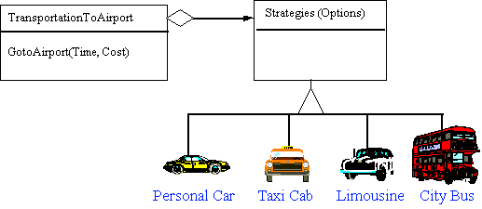
Non-software Example
Modes of transportation to an airport is an example of a Strategy. Several options exist, such as driving one's own car, taking a taxi, an airport shuttle, a city bus, or a limousine service. For some airports, subways and helicopters are also available as a mode of transportation to the airport. Any of these modes of transportation will get a traveler to the airport, and they can be used interchangeably. The traveler must chose the Strategy based on tradeoffs between cost, convenience, and time

Slide 154
Implementation
Strategies might require data to operate on from the Context
Context can push the data to the strategy
Strategy may pull the data from Context
Context class can implement a default behavior of Strategy if a Strategy is not available
Or use Null Object pattern to implement a do-nothing behavior if a strategy is not available
conditional statements are not required to check for existence of strategy (makes the code readable)

Slide 155
C++ Implementation
Templates & function objects can be used to configure a Context with a Strategy.
Only if
the strategy can be selected at compile time
it does not have to be changed at run time
Advantage of using templates is that you can use any callable type as a strategy
Lambda expressions & function pointers can be used as one-shot strategies
No need to have a hierarchy of classes
But no OO advantage with function pointers
Use std::function<> to wrap any callable for flexibility without relying on templates explicitly

Slide 156
Java Implementation
You can use an anonymous class wherever a strategy is required
If the strategy interface is a functional interface, then a lambda expression can be used instead of a class
better than anonymous classes if fields or initialization is not required

Slide 157
C# Implementation
C# supports delegates that are similar to function objects in C++
These can be used to implement strategies instead of creating a hierarchy of classes
More aligned with C# syntax and is still object oriented
supports all OO features

Slide 158
Advantage
Alternative to inheritance
instead of adding new behavior to Context class through inheritance, we use Strategy
Alternative to conditional statements
Code containing many conditional statements often indicates the need to apply the Strategy pattern
Strategies provide different implementations of the same behavior.
A client can choose among strategies with different time and space trade-offs

Slide 159
Disadvantage
The number of classes increase in the application
The client must understand how the strategies differ and which one to choose, so may have to understand the implementation of each

Slide 160
Applicability
Use the Strategy pattern when
classes differ only in their behaviour and you want to configure an application with one of many behaviours
you need different variants of an algorithm
many behaviours of a class are represented through
conditional statements
inherited classes

Slide 161
Known Uses
The CListCtrl in MFC uses a a callback function to sort elements
ACE Library & ATL use Strategy with Null Object Pattern for choosing synchronization primitives through templates
STL provides algorithms that can be customized through function objects or function pointers
In C#, a client can implement custom sorting for any class through IComparer interface. IComparer is a Strategy interface
Java provides a similar interface called Comparable for providing alternative comparisons between objects
In Java, CheckInputStream and CheckOutputStream classes can compute checksums through strategy classes Adler32 and CRC32 that are represented by CheckSum base class

Slide 162
Command Pattern
Encapsulate a request as an object, thereby letting you parameterize clients with different requests, queue or log requests, and support undoable operations
Enables a class to make requests to unknown or unspecified objects.
Such objects have a state and know how to undo their operations
Command pattern decouples the object that invokes the operation from the one having the knowledge to perform it
It is also known as Action/Transaction

Slide 163
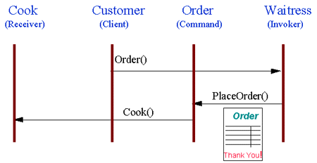
Non-software Example
The Command pattern allows requests to be encapsulated as objects, thereby allowing clients to be paramaterized with different requests. The "check" at a diner is an example of a Command pattern. The waiter or waitress takes an order, or command from a customer, and encapsulates that order by writing it on the check. The order is then queued for a short order cook. Note that the pad of "checks" used by different diners is not dependent on the menu, and therefore they can support commands to cook many different items.

Slide 164
Structure
Client
Invoker
Command
Execute()
Receiver
receiver
ConcreteCommand
Action()
Execute()
receiver->Action();
state

Slide 165
Implementation
A command can either itself perform all operations or just forward the call to receiver
Commands can support undo and redo and have state to supplement these operations. The state can be
the Receiver object, which actually carries out operations in response to the request,
the arguments to the operation performed on the receiver, and
any original values in the receiver that can change as a result of handling the request. The receiver must provide operations that let the command return the receiver to its prior state

Slide 166
Implementation
For undo and redo, copies of existing commands have to be stored in history
You can also create Macros; command objects are stored in a list and executed sequentially
Care should be taken while implementing undo
Some operations are not undoable

Slide 167
C++ Implementation
Can be implemented through
function pointers
function objects
command objects

Slide 168
C# Implementation
Delegates & events can be used to implement callbacks
In this case, the command object is invoked through an event
Simple to implement

Slide 169
Advantages
The invoker and the handler are loosely coupled through the command object
reduces dependency
Can be manipulated and extended like any other object
create variations of commands
Command objects can be assembled
macros
It's easy to add new Commands, because you don't have to change existing classes

Slide 170
Applicability
Commands are object oriented replacement for callbacks
Use if you want to queue and execute requests at different times
Use for implementing undo and redo
commands have state
Can be used for transactions.
In case of a failure, the system can be reverted to original state

Slide 171
Known Uses
Command is extensively used in UI programming while handling callbacks from controls
MFC uses message maps to handle the commands
C# uses events & delegates as commands
provides EventHandler delegate for handling events
Java uses ActionListener as a command object
Boost & QT use signals & slots for commands

Slide 172
State Pattern
Allow an object to alter its behavior when its internal state changes. The object will appear to change its class.
Often, the state changes in an object are managed through conditional statements
code is hard to maintain and reuse
State pattern moves each state into a separate class and the state changes are distributed among the classes
Also known as objects for states

Slide 173
Structure
Context
state
State
Request()
Handle()
ConcreteStateA
ConcreteStateB
state->Handle() ;
Handle()
Handle()

Slide 174
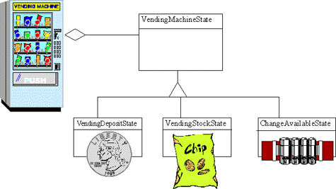
Non-software Example
Notes:
The State pattern allows an object to change its behavior when its internal state changes. This pattern can be observed in a vending machine. Vending machines have states based on the inventory, amount of currency deposited, the ability to make change, the item selected, etc. When currency is deposited and a selection is made, a vending machine will either deliver a product and no change, deliver a product and change, deliver no product due to insufficient currency on deposit, or deliver no product due to inventory depletion.

Slide 175
Implementation
Who specifies the transition?
more appropriate to let the state classes themselves specify the transition
if fixed, Context class can implement them
or a standalone class
State objects can either be created
on the fly, or
as flyweights
Usually, implemented as Singleton objects
Don’t carry any state

Slide 176
Advantages
State-specific behavior is localized in a corresponding class
new states can be added easily
State transitions are represented by objects and not variables.
makes the states more consistent as only one variable(state object) represents the state
State objects can be shared if they don’t store any state
behave as flyweights

Slide 177
Disadvantages
State classes may have to know about each other so that state transitions can take place
May lead to dependency between state classes
When state objects are created on the fly, it leads to repetitive construction & destruction
performance may be effected (use as singleton instead)
When used as flyweights, runtime-costs will be incurred in transferring, finding or computing extrinsic state

Slide 178
Applicability
Use when
object’s behavior depends on its state and its behavior must change at runtime
behavior is decided by conditional statements
behavior is distributed in several operations and each operation contains the same conditional statements

Slide 179
Visitor Pattern
Represent an operation to be performed on the elements of an object structure. Visitor lets you define a new operation without changing the classes of the elements on which it operates
When using the Visitor pattern, you define two class hierarchies
one for the elements being operated upon and one for the visitors that define operations on the elements
New operations can be easily defined by adding a new subclass to the visitor class hierarchy
Based on double dispatch
Notes:
Use for adding more operations to a class without explicitly adding in the class itself.

Slide 180
Structure
Client
Visitor
Structure
VisitConcreteElementA(ConcreteElementA) VisitConcreteElementB(ConcreteElementB)
ConcreteVisitor1
ConcreteVisitor2
VisitConcreteElementA(ConcreteElementA) VisitConcreteElementB(ConcreteElementB)
VisitConcreteElementA(ConcreteElementA) VisitConcreteElementB(ConcreteElementB)
Element
v->VisitConcreteElementB(this)
Object Structure
Accept(Visitor)
v->VisitConcreteElementA(this)
ConcreteElementA
ConcreteElementB
Accept(Visitor)
OperationA()
Accept(Visitor)
OperationB()

Slide 181
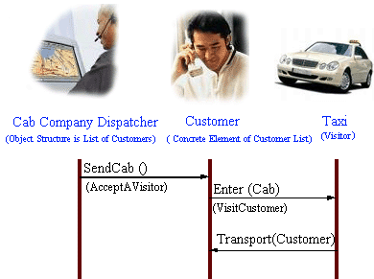
Non-Software Example
Notes:
The Visitor pattern represents an operation to be performed on the elements of an object structure, without changing the classes on which it operates. This pattern can be observed in the operation of a taxi company. When a person calls a taxi company he or she becomes part of the company's list of customers. The company then dispatches a cab to the customer (accepting a visitor). Upon entering the taxi, or Visitor, the customer is no longer in control of his or her own transportation, the taxi (driver) is.

Slide 182
Implementation
A small callback function is added to all classes in the hierarchy
this enables the visitor to visit each class
similar to double dispatch
A visitor must visit each element
the traversal implementation can be put in the object structure, visitor or a separate object called iterator
It is possible to implement this pattern through reflection in C# & Java that support class metadata

Slide 183
Advantages
Adding new operation is easy by just creating a new visitor.
Related behavior of the classes is localized in a visitor.
This simplifies the classes defining the elements and the algorithms defined in the visitors.
Visitors can accumulate state as they visit each element in an object structure.

Slide 184
Disadvantages
It is difficult to add new subclasses of Element.
This would give rise to new operation on Visitor and a corresponding implementation in every ConcreteVisitor class.
Visitor pattern breaks encapsulation
you have to provide public operations to access an element’s internal state.

Slide 185
Applicability
An object structure contains many classes of objects with differing interfaces
you want to perform operations on these objects
Distinct and unrelated operations have to be performed on objects
you want to avoid polluting their classes with these operations
The classes defining the object structure rarely change, but new operations need to be added often

Slide 186
Known Uses
In C# 3.0, a feature called as extension methods is similar to the implementation of the Visitor pattern
Objective C supports categories, which are extensions of existing classes with new methods
Visitor pattern is used in compilers to traverse the nodes of an abstract syntax tree to apply different operations e.g. refactoring, code analysis, etc

Slide 187
Understanding Patterns
It is important to understand the problems that the design pattern solves and even more important the consequences of using the pattern
While designing, knowledge of design principles will automatically give rise to a flexible and extensible design and will make it easier to apply a pattern

Slide 188
Design Patterns Advantages
Give us flexibility, elegancy & reusability
Language independent
Help create a reusable design
Help documenting the architecture of the system and enhance its understanding
Communication between a designer and other designers is improved with fewer chances of errors
Communication between a designer and himself is increased
Increases productivity because you already have the solution for the problem

Slide 189
Design Patterns Disadvantages
Give rise to more objects in a system
The system becomes complex and hard to understand. May lead to performance issues
They are deceptively simple
They can only be validated by experience and intensive discussion
Integrating patterns in software development is a human activity and involves lot of effort
Patterns are tools, not rules
they need to be tweaked and adapted to the problem at hand
Understanding patterns is not straightforward
Its like looking at the solution without knowing the problem

Slide 190
Design Patterns Usage
Novice developer
tries to use patterns everywhere (I have a hammer & everything is a nail)
Intermediate developer
tries to estimate where patterns are needed
forces a pattern on the problem at hand
Expert designer
designs with a simple solution without worrying about design patterns
if flexibility is required, applies a pattern to the problem at hand

Slide 191
Design Pattern Guidelines
Apply Design Patterns extensively while designing a framework/library
The goal should be to reduce the coupling between the framework/library and remaining application
This will ensure that clients can work with new versions of the frameworks
For custom applications
Custom applications usually don’t require design patterns as much as the frameworks
Still, use Design Patterns only if the requirements are clear and the flexibility of the patterns is needed
If requirements are not clear
get the code working with the simplest possible solution
ensure it works as expected
then refactor using a design pattern if the flexibility is required

Slide 192
A Caveat
A Design Pattern should be applied only when the flexibility it offers is ACTUALLY needed
Design Patterns offer flexibility by introducing additional levels of indirections. This makes the code complex and hard to understand

Slide 193
Anti Patterns
An anti pattern discusses a commonly occurring solution to a problem that has a negative consequence upon use
Accordingly to Jim Coplien: "an anti-pattern is something that looks like a good idea, but which backfires badly when applied."
Main causes of failure of the solution are
insufficient knowledge of the domain
inexperience
haste – tendency to “get over” with the problem
Anti patterns advise how to refactor code from following a bad solution. The anti pattern is then converted to a better solution

Slide 194
Examples
The blob – a procedural style of programming where one object has most of the responsibilities in the system and other objects end up only storing data with few or no responsibilities. Also called god object
Base bean – using inheritance to reuse a utility class instead of composition
SomeoneElsesExample – here the developer constructs a system from bits of examples from the web or from other programs. The developer does not take the time to learn all the caveats of the examples and does not take into consideration subtle effects of their combination

Slide 195
Connect
https://www.facebook.com/umarmlone
http://in.linkedin.com/in/umarlone
http://twitter.com/umar_lone

Slide 196
References
Design Patterns : Elements of Reusable Software By GoF [Expert]
Agile Principles, Patterns, and Practices in C# By Martin C. Robert, Martin Micah [Intermediate/Expert]
Design Patterns Explained A New Perspective on Object-Oriented Design Second Edition By Alan Shalloway, James R. Trott [Intermediate]
Head First Design Patterns By Eric Freeman, Kathy Sierra, Bert Bates [Beginner]
C# 3.0 Design Patterns by Judith Bishop [Beginner]
Java(TM) Design Patterns: A Tutorial by James W. Cooper [Beginner]
Design Patterns For Dummies by Steven Holzner [Beginner]

Slide 197
URLs
http://www.dofactory.com
Examples in C#
http:// www.vincehuston.org
Examples in C++/Java
http://sourcemaking.com
Examples in C++/C#/Java
http://www.netobjectives.com
Free webcasts
http://www.blackwasp.co.uk/DesignPatternsArticles.aspx
Examples in Java
http://www.dimecasts.net/Casts/ByTag/Design%20Patterns
Webcasts with examples in C#
http://userpages.umbc.edu/~tarr/dp/spr05/cs446.html
Examples in C++/Java
http://www.ipipan.gda.pl/~marek/objects/TOA/oobasics/oobasics.html
Overview of OO programming

